Slide 1
Hypothermia Prevention Program (HYPO)
Volunteer Training
March 10 - 17, 2024 at
Redeeming Grace Church
Notes:
1

Slide 2
Who is FACETS?
A non-profit that is seeking to break the cycle of poverty and end homelessness in Fairfax County through:
Education and community development
Services to families
Services to single adults

Slide 3
What is HYPO?
The Hypothermia Prevention Program (HYPO) is a low-barrier entry shelter that began in 2003 to provide warm shelter to individuals experiencing homelessness and encourage guests to take steps towards self-sufficiency and stability.
HYPO welcomes:
Any individual who needs a warm place to sleep.
Guests actively under the influence of a substance(s).
Guests actively experiencing mental health concerns.
Please note:
Families may not stay at any of the Hypothermia shelters.
Alert FACETS staff person on-site if someone under the age of 18 shows up or if there is an adult accompanied by a child under the age of 18.
Notes:
Staff will evaluate the individuals’ present state/behavior with regards to the safety of all other guests, staff, and volunteers.

Slide 4
Guest Expectations
What are the expectations of guests participating in the HYPO program?
To be treated with dignity and respect
To have their privacy and confidentiality honored
To be able to make decisions independently (when to go to sleep, when they can smoke cigarettes, etc.)
Dinner and breakfast
A warm place to sleep
For you to listen and encourage them on their journey
Notes:
Staff will evaluate the individuals’ present state/behavior with regards to the safety of all other guests, staff, and volunteers.

Slide 5
Guest Rules
What are the rules for guests participating in the HYPO program?
Guests must sign a copy of the program rules upon HYPO registration for each season.
Violation of the rules may result in suspension and/or termination from the program.
Guests know and understand the rules as they are reviewed nightly by FACETS staff throughout the evening and highlighted during announcements before dinner.
Doors open at 5:00pm and not before and guests must be off property by 7:00am.
Guests are not permitted to leave any belongings in the building.
Guests are assigned a church (red or green) and must go to their assigned church.
If a faith community is over their approved capacity, FACETS staff will begin working on transferring clients.

Slide 6
Volunteer
Expectations
What are the expectations for volunteers participating in the HYPO program?
Welcome, interact, and engage with HYPO guests.
Connect with and welcome FACETS staff (they don’t bite!).
Support FACETS on-site staff as needed, which could include help with handing out bedding in the evenings, collecting bedding in the morning, etc.
Make FACETS staff aware if you see something out of place or of concern.
Be Alert: Patrol your venue and the property for suspicious activity.
Help us be effective by allowing us to enforce our policies.
HAVE FUN!

Slide 7
FACETS Staff
Expectations
What are the expectations for FACETS staff while running HYPO?
Evening staff will locate the POC or volunteer team lead so that both parties know who the other one is.
Staff will need to know any pertinent information for that evening shift.
Information about the morning should also be relayed to evening staff so that they can pass it along during their overnight hand-off.
Staff will run registration & check-in for guests upon arrival.
Interact with guests.
Resolve guest concerns and provide crisis intervention as necessary.
Enforce Hypothermia rules & regulations.
Provide regular updates to FACETS Program and Site Coordinators.

Slide 8
Health & Safety
FACETS staff will work to isolate any guests who presents with flu-like symptoms (fever, chills, etc.).
Before 11:00pm - Staff will contact a FACETS Nurse for advice.
After 11:00pm - Staff will work to quarantine them to avoid passing germs.
Neither FACETS staff nor volunteers should provide any medication without prior approval from the FACETS Nurse.
FACETS staff can administer one dose of Advil/Tylenol.
FACETS Homeless Healthcare Medical Outreach Worker will be out at the HYPO shelters once a week.
The only exception to storing medication is in the case of insulin that needs to be refrigerated.
Please take universal precautions – wash your hands often, use hand sanitizer, and utilize gloves when appropriate.
Should you witness any form of aggression, notify FACETS staff immediately.

Slide 9
Typical
HYPO Timeline
4:30 - 5:00 pm - Staff arrives and prepares to welcome guests.
5:00 pm - Doors open and guests start to arrive.
6:00 - 6:30 pm - Announcements are made and rules are reviewed; dinner commences.
7:00 - 7:30 pm - Bedding is distributed.
10:00 pm - Lights out in sleeping quarters; quiet time.
11:30 pm - Overnight staff arrives and handoff takes place.
12:00 am - Evening staff departs site.
12:00 - 6:00 am - Staff and volunteer conduct “rounds”.
5:30 - 6:00 am - Lights on, breakfast, and morning clean-up.
6:00 - 7:00 am - Laundry pickup occurs (if laundry day).
7:00 am - All guests have left the property; staff makes rounds to ensure it is clean, items are stored correctly, and that all guests have left.
7:30 am - Overnight staff departs site.
Notes:
When giving an overview of the breakfast shift, make it clear that the volunteers on this shift also have to clean the kitchen, fellowship hall, and bathrooms.

Slide 10
Interacting
with Guests
Each guest (or FACETS staff member) you interact with is created in the image of God and has intrinsic worth.
Treat guests with dignity, care, and love.
We are a faith community opening up our doors to care for the poor and marginalized. It is okay to:
Talk about Christ and what He did for sinners.
Ask about what they believe (be prepared for some interesting theology!).
Ask about their story:
Where did they grow up?
Have they traveled much?
What kinds of hobbies do they have, or did they have before they got into their current situation?
Share your story should the guest ask or be interested.
Some guests are siblings in the faith, encourage them and be encouraged by them.

Slide 11
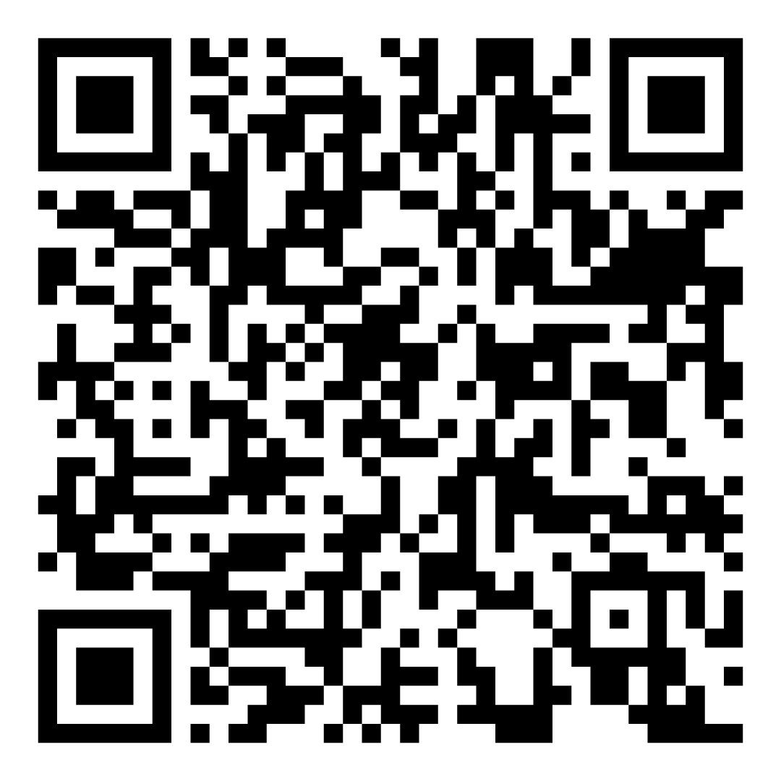
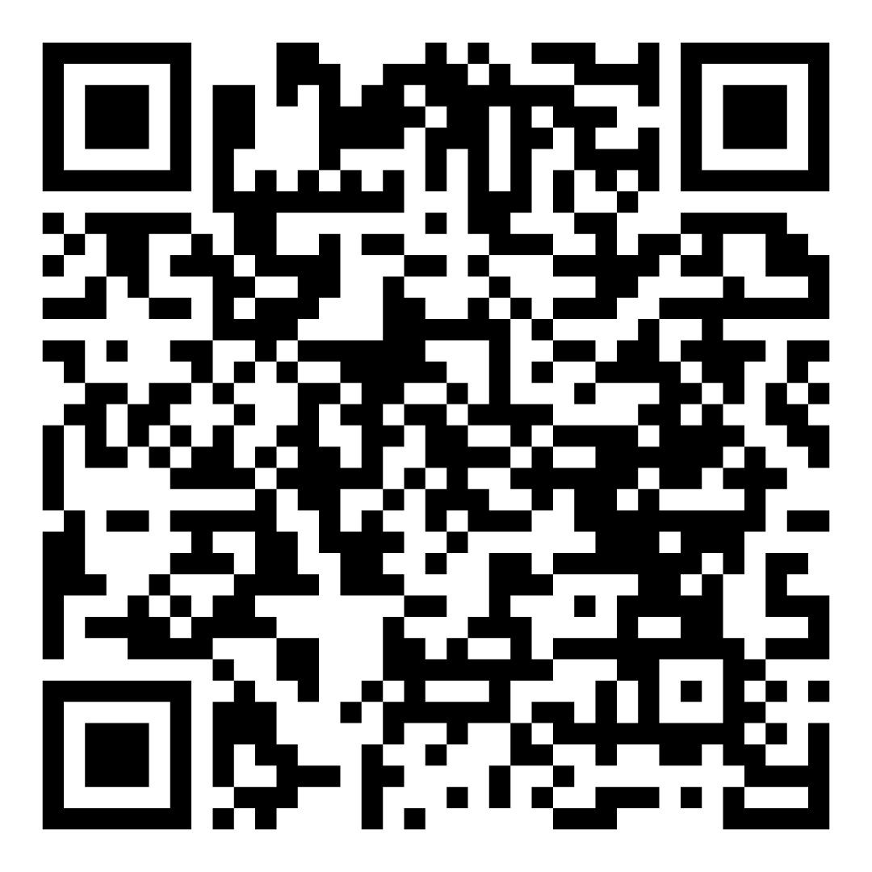
Sign Up to Serve!
Supplies
Bo
Volunteer/Meals

Slide 12
Q & A
Notes:
12

Slide 13
Thanks :)
Notes:
13

